Slide 1
THE GREAT RESET OF CAPITALISM: FROM SHARED VALUE TO INCOME DISTRIBUTION
ITMM – KARSHI STATE UNIVERSITY
Lozhnikova Anna, Professor, National Research Tomsk State University
26.10.2022

Slide 2
2022:There is no market anymore
World Energy- and Agrarian Crises 2022
Great Reset, Davos: 2021
COVID-19
Trade Wars USA-China, USA-EU -2018
Arab Revolution-2010
Global Financial Crisis 2008-2009
Do not pay, UK. Liz Trass.
Jeff Bezos vs. Baiden.
«Price cup» for Russian commodities.

Slide 3
For 200 years, capitalism has gone through 3 phases of relations with the state
1791 – «Сapitalism/market versus state»("invisible hand of the market", critique of mercantilists and patronage of domestic producers);
1891 – «The development of capitalism, within the framework outlined by the state» (after the Great Depression);
1991 - "Capitalism instead of the state" - the funeral of Keynes's ideas, the triumph of individualism (the decline of collective obligations, the departure from the "enterprise as a work collective" paradigm) and social bitterness ( (deregulation, deindustrialization, legal fetishism "there are more lawyers than farmers", USA is a country of shoe shines , financialization).

Slide 4
Obviously, for 10 years sector “gig industry“ accumulated a critical mass of problems
Couriers strike at Delivery Club in Moscow on July 5, 2020

Slide 5
Taxi driver hunger strikes: complaints about aggregator pricing. Why freight rates are falling while online service fees are rising?

Slide 6
August 2020: Uber and Lyft ordered by California judge to classify drivers as employees

Slide 7
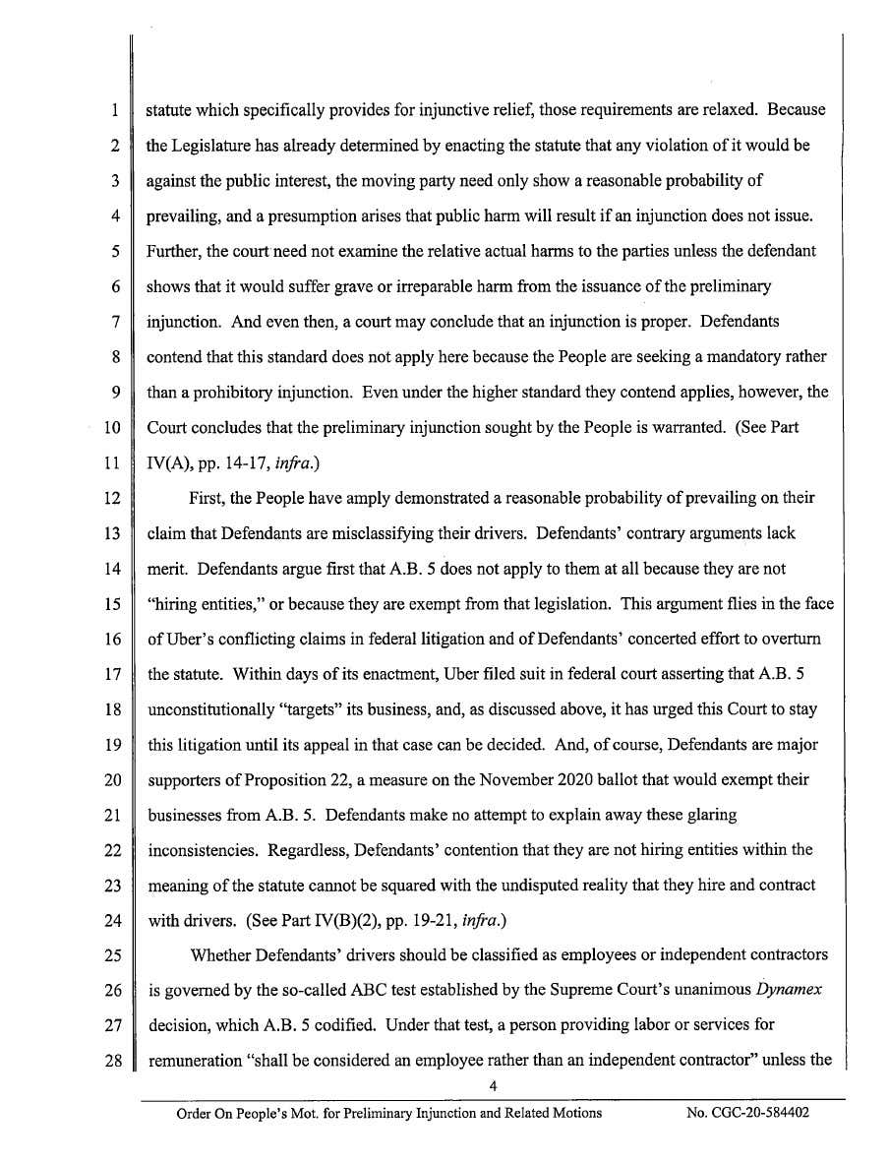
So Uber, Lyft have to adjust their business model
https://www.theverge.com/2020/8/10/21362460/uber-lyft-drivers-employees-california-court-ruling

Slide 8
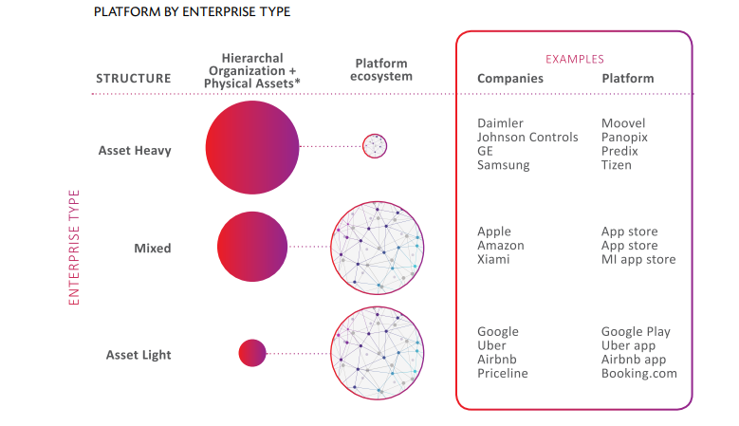
Participants of Digital Ecosystem: platform owners, customers and free agents (self-employed and independent contractors)

Slide 9
https://appfairness.org

Slide 12
Results!
Apple Halves Its App Store Fee for the Smaller Companies
Google Play drops commissions to 15% from 30%, following Apple’s move last year | TechCrunch-2021

Slide 13
Jungle system vs. Ecosystem

Slide 14
IT-Giants: Monopolies, duopolies, oligopolies
The bill is intended to weaken the duopoly of Apple and Google in the field of mobile applications. Democratic Senator Richard Blumenthal compared Google and Apple's dominance of the app market to the monopoly of the railroad companies at the beginning of the last century. He estimated the value of the app store market at about $100 billion a year.
- Yandex will play a monopoly: markets for food delivery, passenger transportation, search market.

Slide 15
Krylov's fable «Swan, cancer and pike»

Slide 16
Russian folk tale about Tops and Roots

Slide 17
Taxi fare structure: Kazahstan

Slide 18
Selfmademan – «a person who owes everything to himself»
Self-employed | Sole proprietorship | Limited liability company (LLC)
Personal Income Tax 4% & 6% | Patent Tax System – min amounts | Income Tax 6% or 15% Tax (Income – Costs)

Slide 19
Patent Tax System – min amounts
Business idea | Location | Proposed legal form, tax system
Atelier for tailoring a classic men's shirt | Тomsk, street Никитина 8а | ИП, ПСН при численности 3 человека. Стоимость патента за 2 месяца 7 420 руб./3710 в месяц, льготы 0% для данного вида деятельности нет. +УСН (Доходы – Расходы), основная ставка в ТО 10%, есть льгота 0% до 31.12.2023 г. если: годовой доход меньше 200/10, численность менее 15, ФОТ на каждого работника не менее 2-хМРОТ, МРОТ на 2023 год 16242р.

Slide 20
Business concept «Creating shared value (CSV)»: proposed by Porter and Kramer in 2011 | Capitalism against Capitalism (M. Alber)
Creating Shared Value (CSV) has been presented as the saviour of capitalism, a way to vanquish the perception that business profit at the expense of society. | Rhenish-Japanese industrial model vs. Anglo-Saxon speculative model.

Slide 21
Market in the Rhenish-Japanese industrial model
 | Non-market goods | Mixed goods | Market goods
Religions | +
Employees' wages |  | +
Housing | + | + | +
Urban transport | + | +
Health care | + | + | +
Education | + | + | +

Slide 22
Home - WID - World Inequality Database https://wid.world/ Tomas Piketty (Paris School of Economics)

Slide 23
Income Inequality: INDICATOR - Top 1% share 2021
Income Inequality: INDICATOR - Top 1% share
2021
USA | China | Russia | Uzbekistan | Turkey
19% | 14-15% | 21% | 17% | 19%

Slide 24
Income Inequality: INDICATOR - Top 1% share 2021
Countries of «Scandinavian socialism model» and Alpian Group
Sweden | Denmark | Norway | Finland | Austria | Switzerland | Germany
10,5% | 13% | 9% | 11% | 10% | 11% | 13%

Slide 25
Income Inequality: INDICATOR - Top 1% share 2021
Countries of Economical Miracle and Dragon Countries
Japan | South Korea | Germany | Taiwan | Singapore
13% | 14% | 13% | 10% | 10%

Slide 26
Wealth Inequality INDICATOR - Top 1% share
USA | China | Russia | Uzbekistan | Turkey
35% | 31% | 48% | 26% | 37%

Slide 27
Wealth Inequality INDICATOR - Top 1% share
Sweden | Denmark | Norway | Finland | Austria | Switzerland | Germany
28% | 22% | 23% | 18,5% | 31% | 31% | 29%

Slide 28
Wealth Inequality INDICATOR - Top 1% share
Countries of Economical Miracle and Dragon Countries
Japan | South Korea | Germany | Taiwan | Singapore
25% | 26% | 29% | 24,5% | 31,5%

Slide 29
Akio Morita (co-founder Sony Corp.) VS. «Abeeconomics»
Rhenish-Japanese industrial model. Akio Morita | Abe Shinzō's Work style reform (was killed on the 8th of July, 2022)
Japan Management VS. American Management | To remedy the Japanese way of work's two greatest problems: dangerously long work hours and grossly unequal wage gaps between regular and non-regular workers

Slide 30
Market in the Anglo-Saxon speculative model
 | Non-market goods | Mixed goods | Market goods
Religions |  | +
Employees' wages |  |  | +
Housing |  |  | +
Urban transport |  |  | +
Health care |  |  | +
Education |  |  | +

Slide 31
Text on the distribution of ownership in «Pixar» from W. Isaacson's book on Steve Jobs
“The final agreement was reached in January 1986. For his $10 million investment, Jobs received 70% of the company, with the rest distributed among Ed Catmull, Alvy Ray Smith, and 38 other founding employees, down to the receptionist.”
Employees are co-owners-shareholders of the world's largest companies: Walmart, CVS Health Corporation, McKesson, Exxon Mobil, AT&T, Microsoft Corporation, Verizon Communications Inc., Ford Motor Company, GE, Intel, IBM (ESOP, Employee Stock Ownership Plan), etc.

Slide 32
Modern trends: Moral capitalism/ Сonscious capitalism/ Capitalism without capitalists
- ESOP (Employee Stock Ownership Plan);
B-Corporations and Public-Benefit Corporations (Kickstarter);
Turquoise Organizations
- «Norilsky Nikel»-2022

Slide 33
Kickstarter Inc is no more. We’re now Kickstarter PBC — a Public Benefit Corporation.

Slide 34
https://www.kickstarter.com/charter
Kickstarter is committed to fighting inequality.
Kickstarter will report on team and leadership demographics, executive and CEO pay ratios, and programs and strategies employed to build a diverse, inclusive, and equitable organization.

Slide 35
Original model-XXI «Labor managed firms»
Free-pricing capitalism with private ownership of the means of production
Vs. collective ownership of the means of production and means of production, managed by employees and state.

Slide 36
